Slide 1
Gov 1780: International Political Economy
Section 5
25 Feb 2021

Slide 2
Agenda
Bailey, Goldstein, & Weingast: “The Institutional Roots of American Trade Policy”
This is probably the most technical piece we’ve read so far… so let’s go through it step-by-step!
Essay practice
Essay #1 is coming up on March 3rd!

Slide 3
Part 1
Bailey, Goldstein, & Weingast
“The Institutional Roots of American Trade Policy”

Slide 4
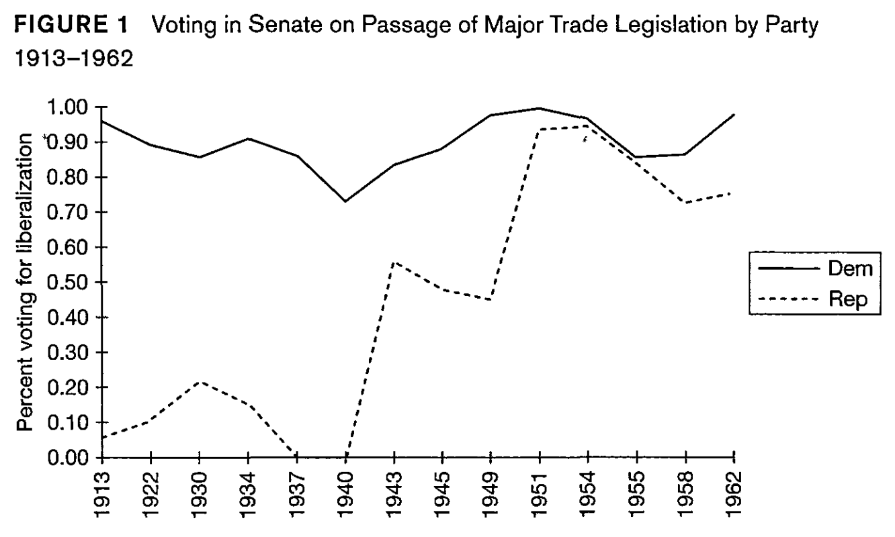
The partisan politics of trade
In the 20th century:

Slide 5
The partisan politics of trade
In the 20th century:
Democrats are the free trade party

Slide 6
The partisan politics of trade
In the 20th century:
Democrats are the free trade party
Republicans are protectionist but gradually become more free trade

Slide 7
The partisan politics of trade
In the 20th century:
Democrats are the free trade party
Republicans are protectionist but gradually become more free trade
What changed?

Slide 8
The partisan politics of trade
In the 20th century:
Democrats are the free trade party
Republicans are protectionist but gradually become more free trade
What changed?
RTAA passed 1934

Slide 9
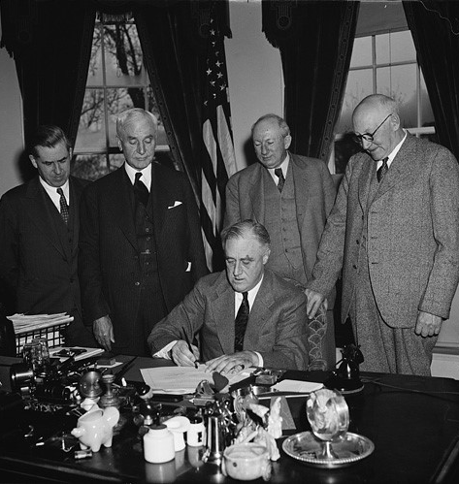
Reciprocal Trade Agreements Act (RTAA)
Two big changes in the 1934 RTAA:
it mandated reciprocal, not unilateral, tariff reductions
aka, issue linkage
it authorized trade agreements on the basis of a simple majority vote instead of the supermajority mandated in the Constitution
aka, institutional thresholds

Slide 10
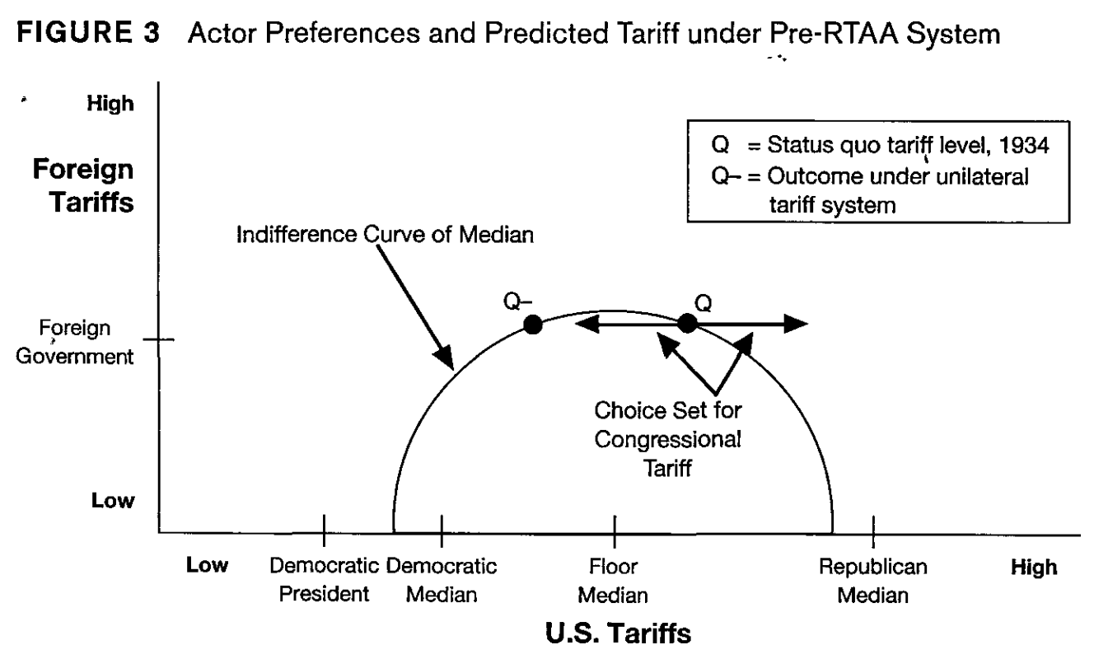
Ideal points
This diagram shows the “ideal points” of different actors.

Slide 11
Ideal points
This diagram shows the “ideal points” of different actors.

Slide 12
Actors
This diagram shows the “ideal points” of different actors.
For simplicity, the “rest of world” is represented as just one foreign government.

Slide 13
Actors
This diagram shows the “ideal points” of different actors.
For simplicity, the “rest of world” is represented as just one foreign government.
All US actors want low foreign tariffs

Slide 14
Actors
This diagram shows the “ideal points” of different actors.
For simplicity, the “rest of world” is represented as just one foreign government.
All US actors want low foreign tariffs
Foreign government wants low US tariffs

Slide 15
Indifference curves
The “Indifference Curve of Median” represents combinations of foreign and US tariffs that are equally good/bad to the US floor median.
Why?

Slide 16
Indifference curves
The “Indifference Curve of Median” represents combinations of foreign and US tariffs that are equally good/bad to the US floor median.
Why?
Because the floor median dislikes policies that are further from their ideal point. The semi-circle shows points that are equidistant from that point.
r
r

Slide 17
Indifference curves
Which combination of tariffs does the Floor Median prefer: Q or Q- ?
r
r

Slide 18
Indifference curves
Which combination of tariffs does the Floor Median prefer: Q or Q- ?
Trick question! Since Q and Q- both lie on the same indifference curve, the Floor Median is indifferent between them.
Foreign tariffs are held constant, but US tariffs are now slightly below (vs slightly above) the Floor median’s ideal point.
r
r

Slide 19
Order of the game
Assume that the Democrats control Congress and the Presidency.
How does Congressional legislation work in this simplified model?

Slide 20
Order of the game
Assume that the Democrats control Congress and the Presidency.
How does Congressional legislation work in this simplified model?
The Democratic Median proposes a unilateral change
unilateral change = foreign tariffs held constant

Slide 21
Order of the game
Assume that the Democrats control Congress and the Presidency.
How does Congressional legislation work in this simplified model?
The Democratic Median proposes a unilateral change
It is passed or rejected by the Floor Median
unilateral change = foreign tariffs held constant

Slide 22
Role of the Democratic Median
Which combination of tariffs does the Democratic Median prefer: Q or Q- ?

Slide 23
Role of the Democratic Median
Which combination of tariffs does the Democratic Median prefer: Q or Q- ?
Q- is closer to the Democratic Median’s ideal point, hence is preferred over the status quo, Q.
r- < r
r-
r

Slide 24
Role of the Democratic Median
Which combination of tariffs does the Democratic Median prefer: Q or Q- ?
Q- is closer to the Democratic Median’s ideal point, hence is preferred over the status quo, Q.
Put another way: the indifference curve passing through Q- lies inside the indifference curve passing through Q.
r-
r

Slide 25
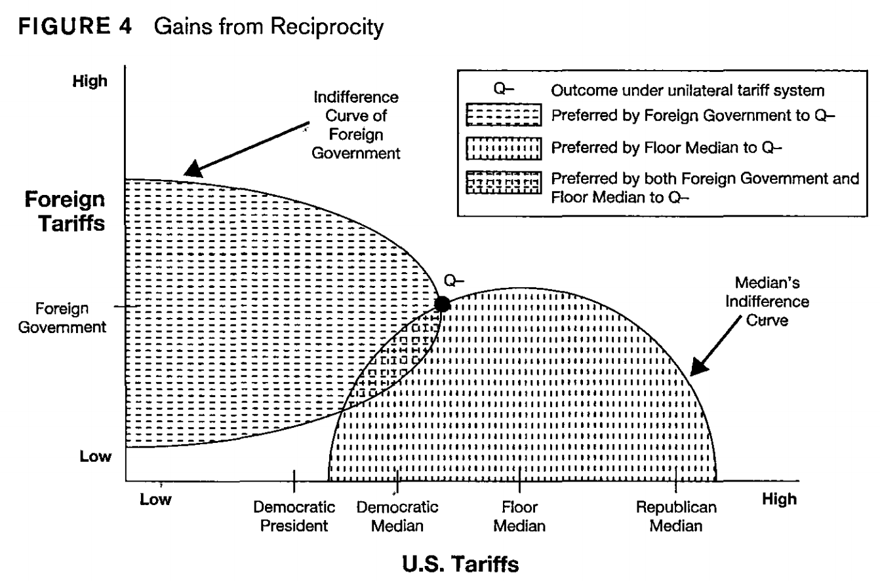
We can do better!
Here’s the problem:
While the Democratic Median does prefer Q- over Q, there are still a range of policies that are even better than Q- for the Democratic Median, the Floor Median, AND the Foreign Government!!

Slide 26
We can do better!
Here’s the problem:
While the Democratic Median does prefer Q- over Q, there are still a range of policies that are even better than Q- for the Democratic Median, the Floor Median, AND the Foreign Government!!
But Congress can’t get there unilaterally. Accessing these policies requires bilateral negotiations with the foreign government.
unilateral change = foreign tariffs held constant

Slide 27
Order of the game
Under the RTAA, the sequence of the game has changed:

Slide 28
Order of the game
Under the RTAA, the sequence of the game has changed:
Democratic median proposes a minimum tariff level
Floor median agrees (or not)
Domestic
bargaining

Slide 29
Order of the game
Under the RTAA, the sequence of the game has changed:
Democratic median proposes a minimum tariff level
Floor median agrees (or not)
President proposes a new set of tariffs to the foreign government
Foreign govt agrees (or not)
Domestic
bargaining
International
bargaining

Slide 30
Order of the game
Under the RTAA, the sequence of the game has changed:
Democratic median proposes a minimum tariff level
Floor median agrees (or not)
President proposes a new set of tariffs to the foreign government
Foreign govt agrees (or not)
If no agreement, Congress passes a unilateral tariff reduction to Q-
Domestic
bargaining
International
bargaining

Slide 31
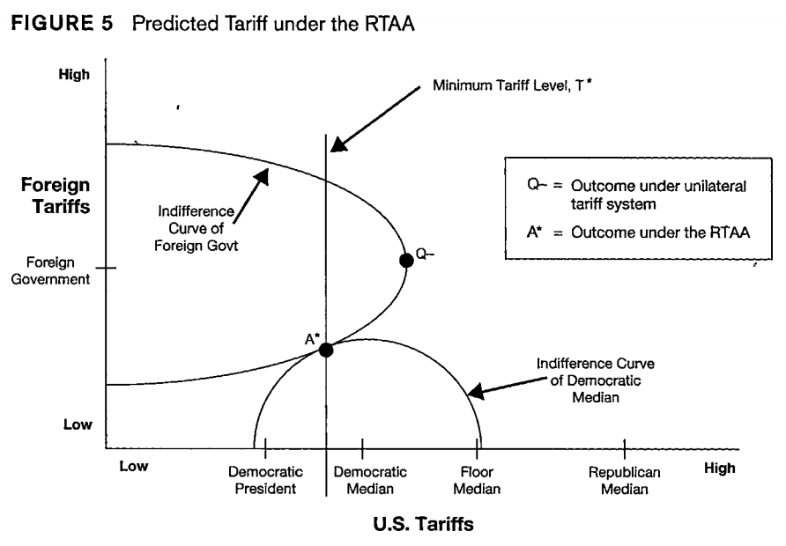
New equilibrium under the RTAA
Compared to the unilateral tariff system:

Slide 32
New equilibrium under the RTAA
Compared to the unilateral tariff system:
Foreign tariffs are lower

Slide 33
New equilibrium under the RTAA
Compared to the unilateral tariff system:
Foreign tariffs are lower
US tariffs are lower

Slide 34
Part 2
Essay practice

Slide 35
Essay practice
One of the key skills you will need to write a good Gov 1780 is knowing how to use historical examples to illustrate and back-up your argument.
So let’s practice!

Slide 36
Group 1: Thinking of relevant historical examples
One of the most important features of the RTAA was that it “created a dynamic of political support for free trade” -- i.e., it was self-reinforcing.
Can you think of other examples of institutional changes that were self-reinforcing?

Slide 37
Group 2: Using historical examples to make a point
Example essay question: How do domestic politics shape a country’s behavior in the international arena?
Describe a mechanism that links domestic politics to international outcomes and think of a specific historical example(s) that illustrates that mechanism.

Slide 38
Group 3
Student’s choice! You can choose to tackle either the Group 1 or the Group 2 prompt.

